Slide 1






Enhancing the User Experience with jQuery
Helping developers with greater capabilities, more flexibility, and user adoption
Andy Boettcher, Demand Chain Systems, Senior CRM Advisor
facebook.com/techman97
@andyboettcher
in/andyboettcher
andyboettcher.com

Slide 2
Safe harbor
Safe harbor statement under the Private Securities Litigation Reform Act of 1995:
This presentation may contain forward-looking statements that involve risks, uncertainties, and assumptions. If any such uncertainties materialize or if any of the assumptions proves incorrect, the results of salesforce.com, inc. could differ materially from the results expressed or implied by the forward-looking statements we make. All statements other than statements of historical fact could be deemed forward-looking, including any projections of product or service availability, subscriber growth, earnings, revenues, or other financial items and any statements regarding strategies or plans of management for future operations, statements of belief, any statements concerning new, planned, or upgraded services or technology developments and customer contracts or use of our services.
The risks and uncertainties referred to above include – but are not limited to – risks associated with developing and delivering new functionality for our service, new products and services, our new business model, our past operating losses, possible fluctuations in our operating results and rate of growth, interruptions or delays in our Web hosting, breach of our security measures, the outcome of intellectual property and other litigation, risks associated with possible mergers and acquisitions, the immature market in which we operate, our relatively limited operating history, our ability to expand, retain, and motivate our employees and manage our growth, new releases of our service and successful customer deployment, our limited history reselling non-salesforce.com products, and utilization and selling to larger enterprise customers. Further information on potential factors that could affect the financial results of salesforce.com, inc. is included in our annual report on Form 10-Q for the most recent fiscal quarter ended July 31, 2012. This documents and others containing important disclosures are available on the SEC Filings section of the Investor Information section of our Web site.
Any unreleased services or features referenced in this or other presentations, press releases or public statements are not currently available and may not be delivered on time or at all. Customers who purchase our services should make the purchase decisions based upon features that are currently available. Salesforce.com, inc. assumes no obligation and does not intend to update these forward-looking statements.

Slide 3
Introduction
Andrew Boettcher
Background
Systems Engineer / Architect (MCSE)
Software Development
VoIP Telephony Integrations
Rumblings and Aspirations
Senior CRM Advisor, Demand Chain Systems (Minnesota)
Twin Cities (MN) Developer User Group Leader
Evangelizing Force.com – what a platform!

Slide 4

Demand Chain Systems
If lasting CRM success was easy, everyone would already have it. Demand Chain Systems brings a unique model-based structure which greatly simplifies CRM success. Our approach is the perfect complement to the industry leading Salesforce.com platform.
Structured Roadmaps
Structured Deployments
Lasting CRM Success

Slide 5
Agenda
What exactly are we doing here today?
Who are you?
What is jQuery / jQueryUI?
Why is it important to use technologies like jQuery?
How much is too much or too little?
Examples of jQuery / jQueryUI
Resources
Ping your peers / Q & A

Slide 6
What is jQuery / jQueryUI?
jQuery (www.jQuery.com)
Fast and Concise JS Library
Simplifies HTML Document Traversing
Event Handling
Animations
Ajax Interactions
jQueryUI (www.jQueryUI.com)
Built on top of jQuery
Low-level Interaction and Animation
Advanced Effects
Themeable Widgets

Slide 7
What REALLY is jQuery / jQueryUI?
A tool in your development arsenal.
Help users see data easier
Help users work with data more effectively
Help management understand data better

Slide 8
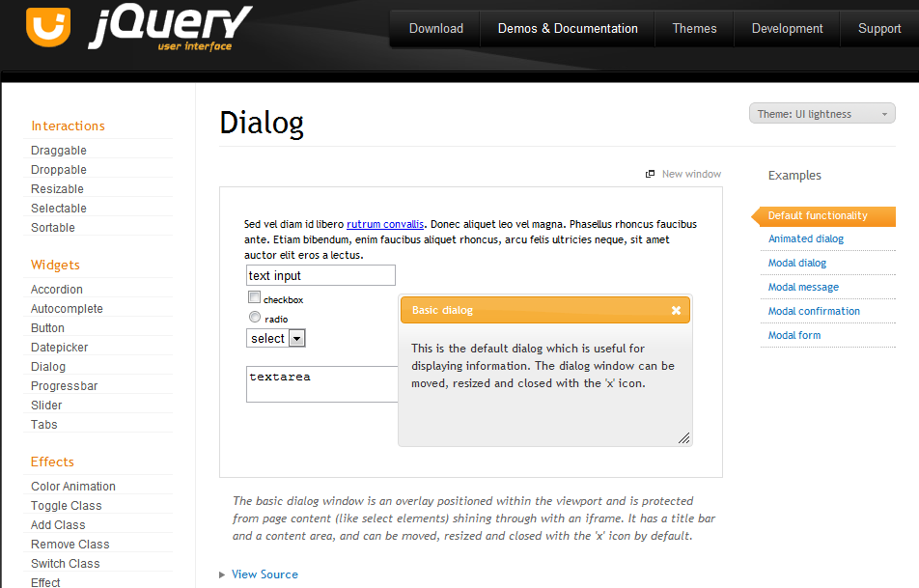
jQueryUI – demos and documentation

Slide 9
Why important? Developers vs. Users
Developers use systems like developers
Technically-minded
Self-correcting
Understanding of “glitches”
Can switch paths mid-stream
Users use systems like users
Process-minded
Expectation of reliability and repeatability
Frustrated easily with “glitches”
Users single-handedly hold the key to ultimate “adoption”

Slide 10
Too much? Finding the “Goldilocks Zone”
Good guidelines while considering jQuery
jQuery components are never a focus, they compliment
Salesforce is very powerful; leverage your platform
Augment, augment, augment
Replace only as a last resort
jQuery is open-source
Search far and wide for plug-ins
Ask your users and leverage the Community!
Be proactive, not reactive!
#askForce / Force.com Discussion Boards
StackExchange

Slide 11
How to get started with jQueryUI
Static Resource
Create a ZIP file of assets
Bundle core, widgets, and plugins in one file
Add to your org
Reference
External Resource (Google Code)
Reference the external resource in your Visualforce Page
https://developers.google.com/speed/libraries/devguide

Slide 12
Questions and open forum
What are your thoughts so far?
Ready to see specific functionality?
Let’s hear from you!
What have YOU done with jQuery / jQueryUI?

Slide 13
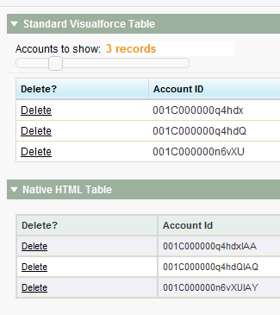
Example 1: Table sorting and inputs
Core jQuery Library
jQueryUI Library
Plugin: Tablesorter
Widget: Slider

Slide 14

Example 1: Sorting and inputs recap
Extend native functionality
Augment with HTML and jQuery functionality
Always compliment; never overwhelm
Be subtle
Think “Speed”
Think “User”
Think “Process”
Questions?
What do YOU think?

Slide 15
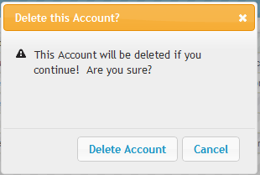
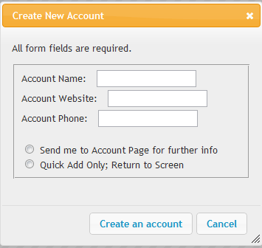
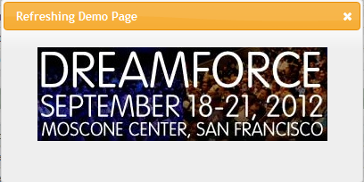

Example 2: Status and modal dialogs
Core jQuery Library
jQueryUI Library
Widget: Modal Dialog
<apex:actionFunction>

Slide 16
Example 2: Status and modal dialogs recap
Extend native functionality
Augment with HTML and jQuery functionality
Always compliment; never overwhelm
Be subtle
Think “Speed”
Think “User”
Think “Process”
Questions?
What do YOU think?

Slide 17
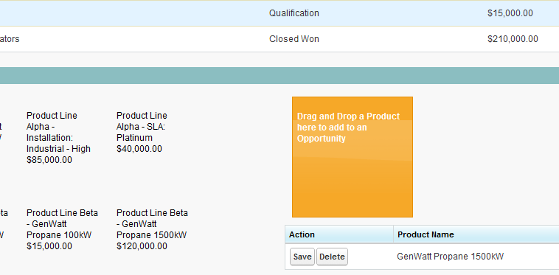
Example 3: Drag and drop and HTML5
Core jQuery Library
jQueryUI Library
Interaction: Draggable
Interaction: Droppable
<apex:actionFunction>
HTML5: Data attribute

Slide 18
Example 3: Drag and drop / HTML5 recap
Extend native functionality
Augment with HTML and jQuery functionality
Always compliment; never overwhelm
Be subtle
Think “Speed”
Think “User”
Think “Process”
Questions?
What do YOU think?

Slide 19
Recap
Why is it important to use technologies like jQuery / jQueryUI?
How much is too much or too little?
You are the front line to user adoption!
Resources – never be afraid to ask for advice
Twitter: #askForce
Salesforce developerforce boards
Reach out to bloggers and peers
Github link - https://github.com/techman97/SFDC_Code

